Slide 1
Sinic Brilliance Machinery (Luoyang) Co.Ltd
Efficiency High ,Energy Saving
Cost-efficent ,Compact Design
Concrete Batching Plant

Slide 2
Our Design Concept Focus On
1. Make our plant capable to reduce producing /running cost to the utmost extent , save money for client.
2. Make “simpletons” type plant of simplest and easiest operation, so that the client has not to employ highly-demanding operators to run the plant, lessen the pressure of human resource and make the personnel managing easiest and at lowest cost.

Slide 3
Two Series of Plant
1. batching plant (HZS）
2. continuously mixing plant (HZL）
A type | B type | C type
HZS60A | ---- | ----
HZS90A | HZS90B | HZS90C
HZS120A | HZS120B | HZS120C
HZS180A | HZS180B | HZS180C
---- | HZS200B | HZS200C
---- | ---- | HZS240C
---- | ---- | HZS270C
HZL150
HZL200

Slide 4
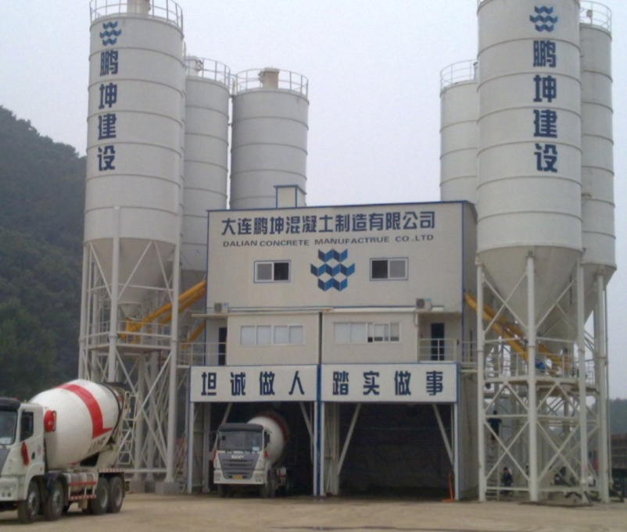
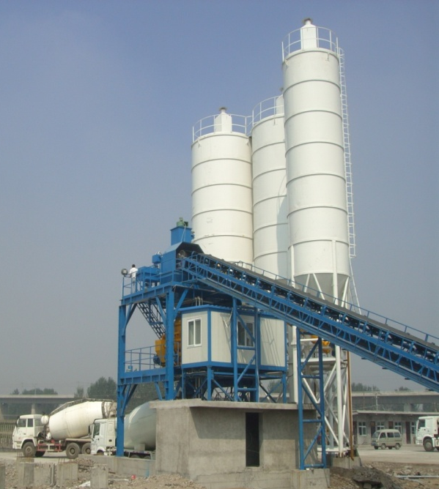
Three Different Designs/Constructions
A type（old conventional design）
Single plant
Twin plants
Characteristic：cement silos around mixer station at sector arrangement layout. Occupy more land area. Need much longer screw conveyors. The foundation is bigger and need more piling works, cost much higher.

Slide 5
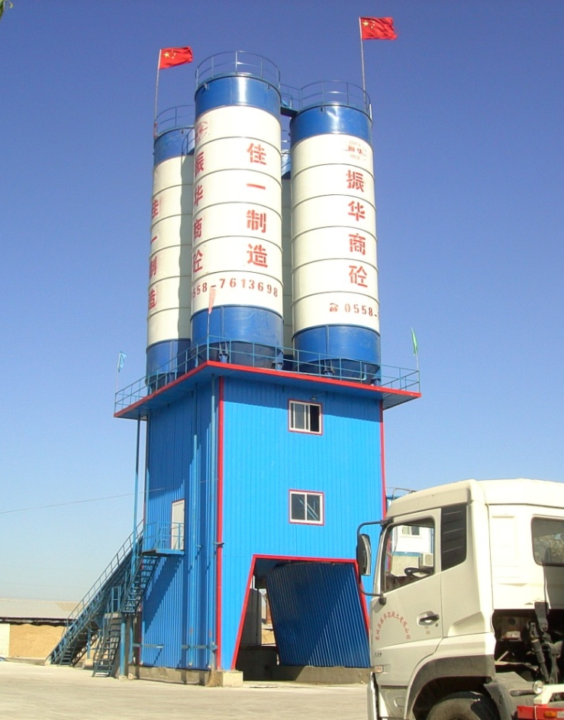
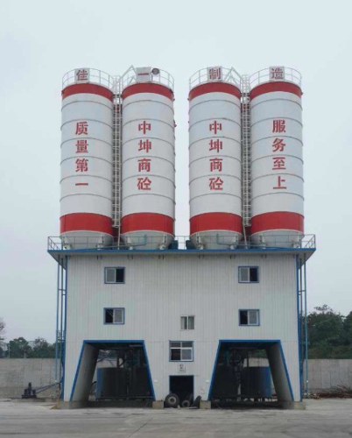
Three Different Designs/Constructions
B type（new design）
Characteristics：cement silos located at the top of the mixer station, only1.5m higher, very compact design, foundation smaller, save land area, cost much less.
Single plant
Twin plants

Slide 6
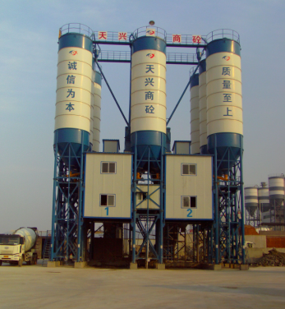
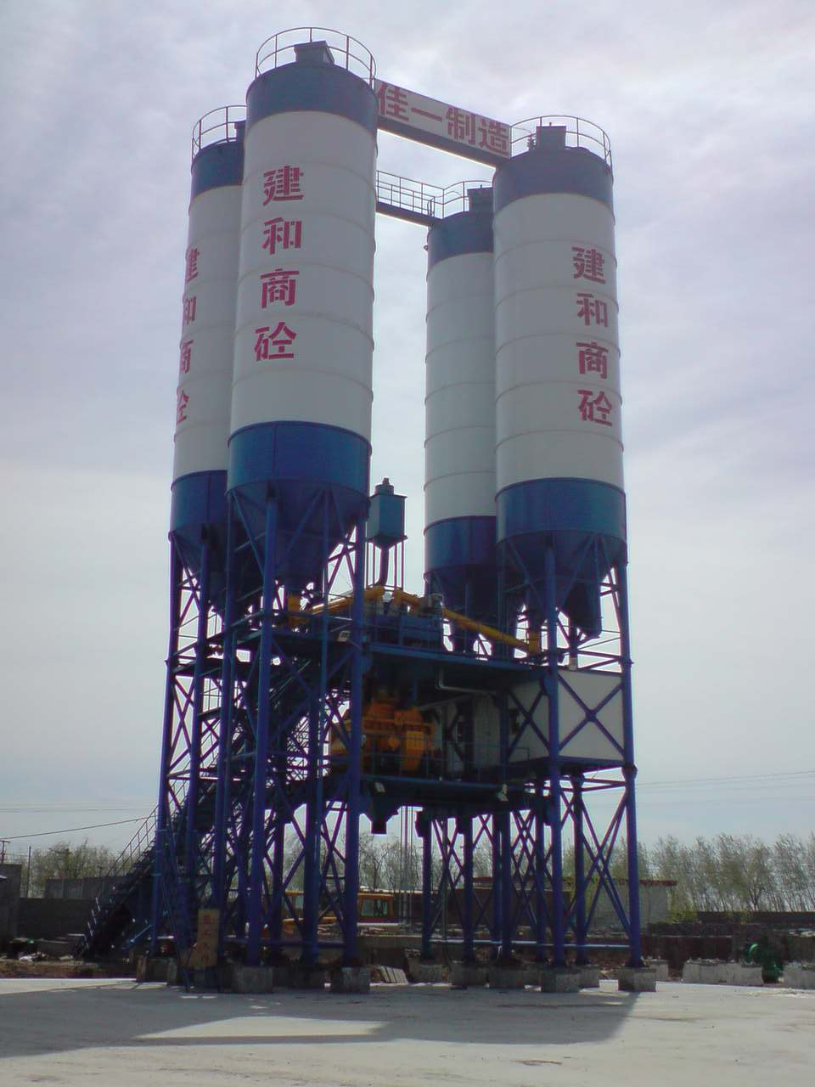
Three Different Designs/Constructions
C type（new design）
Characteristics：compact and modular design, plant extendable.
Twin plants
Single plant

Slide 7
Four Characteristics
Save energy：2 units of HZS180 plant can share one 250KW transformer
Environment friendly: zero emission of three pollutants (dust, noise and waste water)
Appearance: wonderful style, looks splendid, majestic
High efficency：HZS180 plant peak production can achive 200 cbm/hr

Slide 8
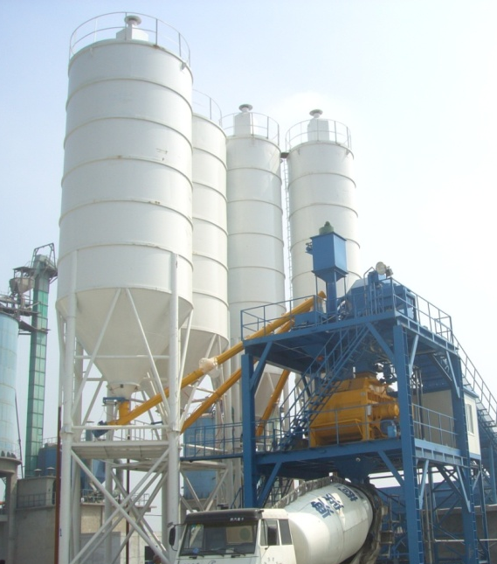
Achieve high efficiency:
cement feeding speed 2 times faster
A type
B type
Design | Length of screw conveyor | Inclined angle of screw conveyor | Cement feeding speed
Conventional design（A type） | 12 m | More than 30° | slow
New design（B、C type） | 4 m | About 15° | fast

Slide 9
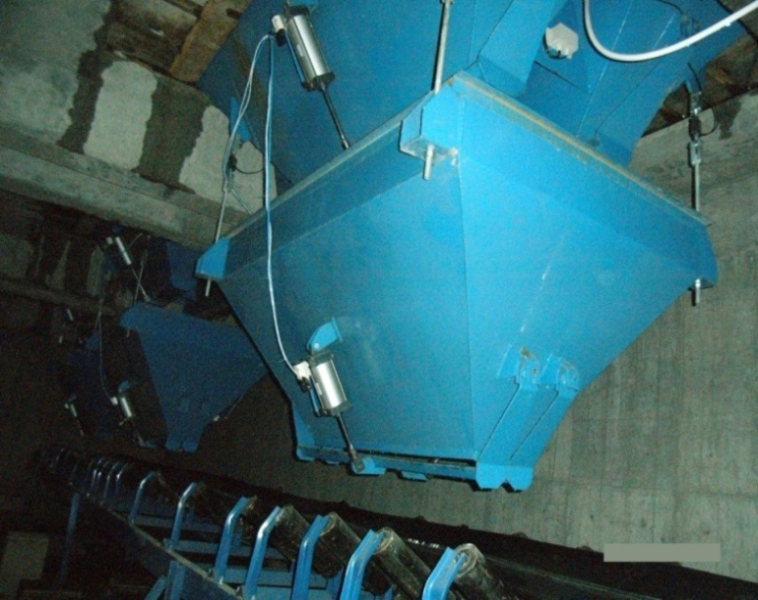
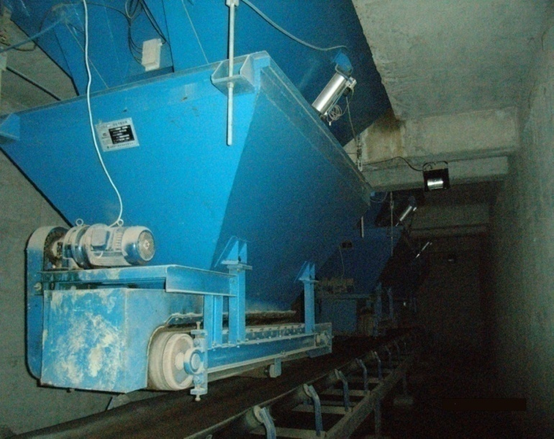
Achieve high efficiency:
aggregates feeding speed 2 times faster
“Addition ” weighing
“ Subtraction” weighing
weighing technology | weighing accuracy | Aggregats fall sequence | remark
“Addition ” weighing | ±2% | one aggregate falls, one after another | violent impact onto conveyor belt due to aggregates falling; aggregates may sprinkle out; vibrator needed to prevent sand hopper blocked.
“ Subtraction” weighing | ±0.1% | All aggregates fall synchronously | Almost no impact onto conveyor belt; no aggregates sprinkle out; sand hopper no blocked

Slide 10
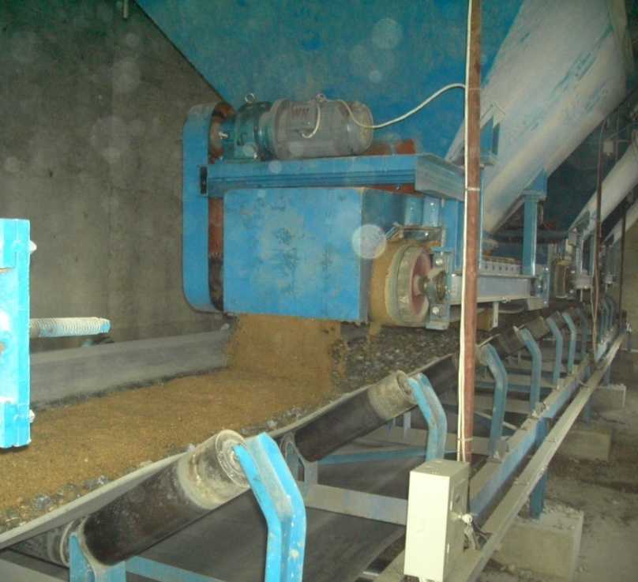
Introduction of our patented “subtraction” weighing technology and device
Subtraction weighing：aggregates falling by means of forcible extracting by small belt conveyors. The small motors drive the belts, the belts take out all aggregates synchronously and they are uniformly laid onto the belt conveyor underneath.

Slide 11
Subtraction weighing: patent technology guarantee high precision of material weighing
Additioin weighing
When weighing end and storage hopper gate closed, there is still some material falling between the gate and measuring hopper. Even by coarse+fine or inching weighing, the weight tolerance can achieve ±2%.
Subtraction weighing
Addition weighing device
Due to the materials are extracted by small belt conveyors, no material falling between the storage hopper gate and measuring hopper, the weighing accuracy is 20 times better, the weight tolerance can achieve ±0.1%.
Subtraction weighing device

Slide 12
Subtraction weighing: weighing faster, batching efficency much hihger
Addition batching
After weighing finish, the material start falling; Only one material fall per time.
subtraction batching
Materials weighing and falling happen at same time. When belt running, weighing and discharging executed synchronously. 4 aggregates can fall at same time. 3/4 of falling time can be saved, therefore the batching efficiency is greatly enhanced.
Addition weighing device
Subtraction weighing device

Slide 13
Subtraction weighing: aggregate in storage bin no bridging and no blocked
addition weighing
In order to control weighing accuracy, the hopper gate can not be so big, so the aggregate in hopper is easy brdging and blocked. Hence vibrator must be installed on hopper. And even with vibrator, the bridging/blocking can not be avoided, and manually deblocking work is still necessary. This not only increase backbreaking labor, but also waste time, decrease efficiency.
Subtraction weighing
Due to the aggregates are extracted by small belt conveyor, even sand is very wet, no bridging happen and no blocked, vibrator and manually deblocking are unnecessary. This less the labor works and no vibrating noise, save cost, increase the efficiency
Addition batching
Subtraction batching

Slide 14
Subtraction weighing: longer service life
Addition weighing / batching
Aggregates falling violently impact onto the belt, this makes instant power consumption of belt motor remarkably increased, and decrease service life of conveyor belt and motor .
Subtraction weighing / batching
Sand and stone fall synchronously and uniformly, very little impact exert onto belt and motor. Sand and stone synchronously fall on the belt and conveyed in premixed state of sand layer together with stone layer. Then by falling from horizontal belt onto inclined belt, from inclined belt to intermediate hopper, and finally fall into mixer. During the conveying, the aggregates are already premixed 3 times before enter into mixer. This shorten mixer working time and extend the its service life
Addition weighing
Subtraction weighing

Slide 15
Short video show Subtraction weighing /batching process
Click Left Screen
To watch the video that show the actual effect of Subtraction Weighing Batching technology

Slide 16
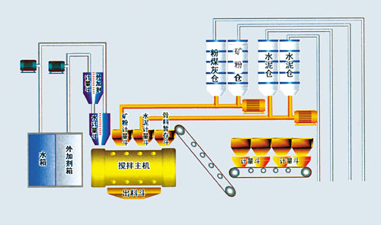
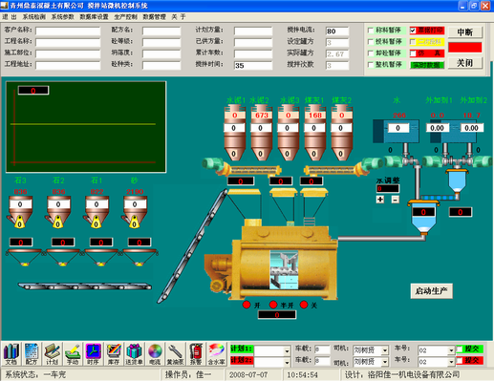
Achieve high efficiency:
control system can switch two tasks in “gapless” way
Conventional control system
Formula oriented
Interface show less contents
Formula change has to be done manually by operator
Jiayi control system
Producing task oriented
Interface show full contents
Automatic control, operation simple and easy
Production efficiency is low
Dual task control, “gapless” switch, producing efficiency is much higher

Slide 17
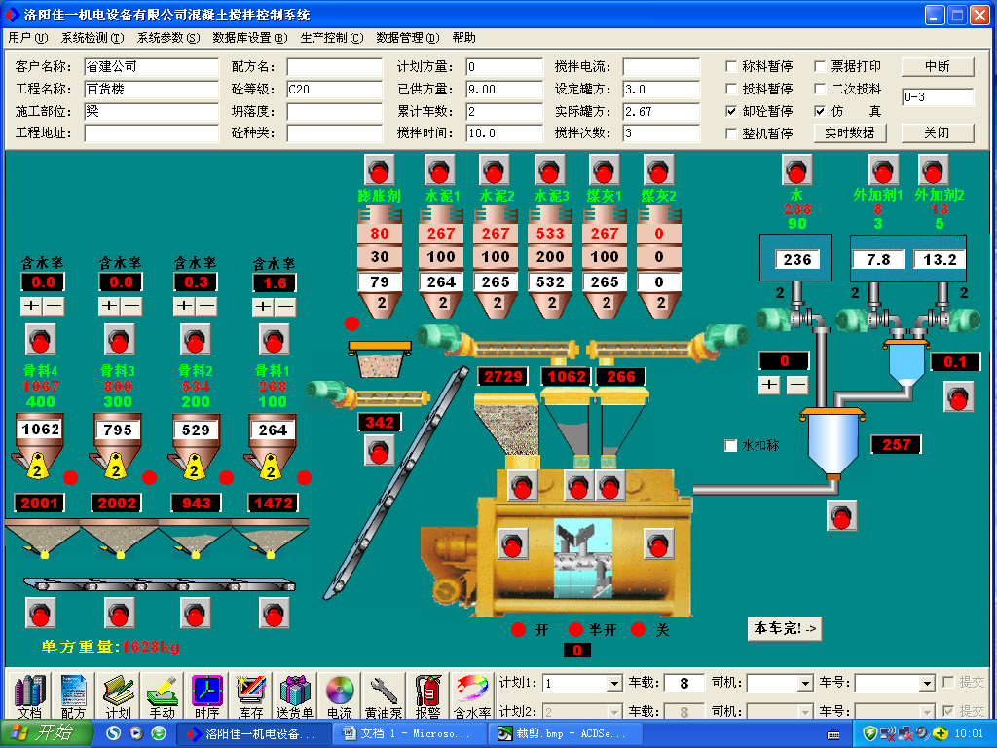
Jiayi Control System

Slide 18
Achieve higher efficiency
How to achieve
high efficiency
Cement feeding speed
2 times faster
Cement conveyors length much shorter
Cement conveyors incline angel much smaller
Control system “gapless” connection
By multi-task production mode
aggregates feeding speed
2 times faster
By subtraction weighing,
all aggregates fall synchronously
By subtraction weighing，materials falling while weighing

Slide 19
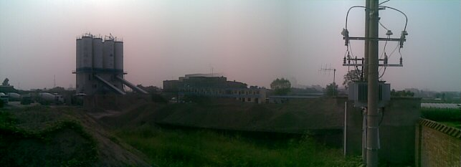
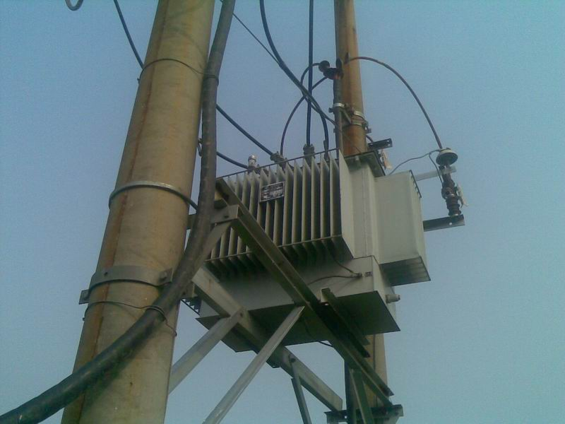
Remarkable Energy Saving:
Installation power is much less because new design
Conventional design：
two HZS180A plants need 500—600 kw transformer.
New compact design：two HZS180B plants need 250 kw transformer

Slide 20
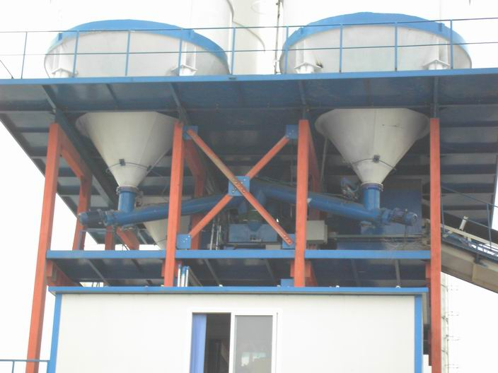
Conventional plant: A type, 4 screw conveyors, installed power is 18.5*4 =74KW. Besides, the conveyors shaft bearings need often maintenance. The maintenance work is almost 1/3 of the maintenance of the whole plant.
Remarkable Energy Saving:
save electricity
New compact plant: B type, 4 screw conveyor and each 5.5KW，total power is 4*5.5=22KW. Besides, there is no bearing and no need maintenance.

Slide 21
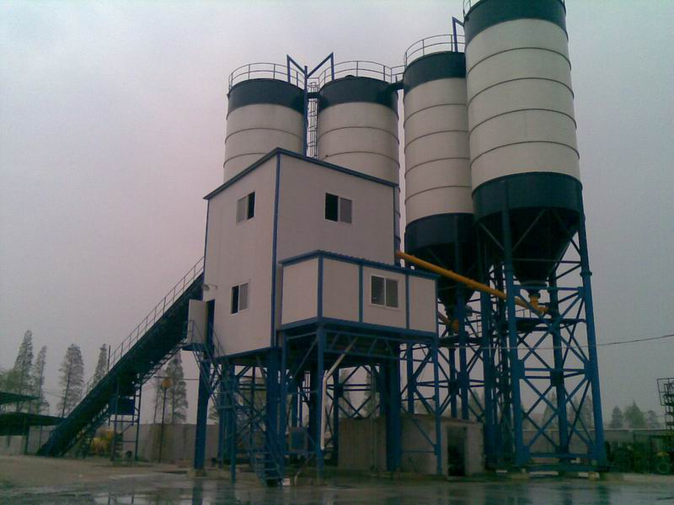
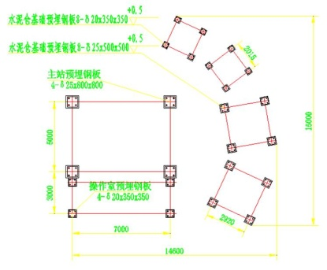
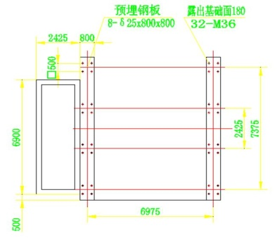
Remarkable Energy Saving:
Foundation / land area smaller
Plant design | Land area | Qty of piles | Foundation construction
Conventional design（A type） | 15×15=225m² | 24 pcs | Cost higher, more difficult
New design（B, C type） | 8×9=72m² | 8 pcs | Cost less, much easier
Difference | 153㎡ less | 16 pcs less | Save about US$15,000

Slide 22
Economical benefit
due to higher efficiency and energy saving
Conventional design （A type） | New compact design （B, C type） | Save cost
Land area 225 m² | Land area 72 m²
Foundation need 24 piles | Foundation need 8 piles
Each screw conveyor 18.5KW | Each screw conveyor 5.5KW
Screw conveyor maintenance cost US$7500/year | Maintenance free
aggregates falling consume power | Aggregates falling consume no power
500-600KW transformer need extra license charge US$18,000 | 250KW transformer no need extra charge

Slide 23
Economical benefit
due to higher efficiency and energy saving
Due to higher efficiency，our new design plant takes only 4 minutes to load 12 cbm mixer truck; However, the conventional plant takes around 7 to 8 minutes. These 4 minutes time saving directly reduce the cost of electricity, fuel, manpower and wages, etc.
Therefore, use our plant, not only the initial construction invest is less, but also the later running cost is much less.According to the static data from our client, use our new design plant, to produce 1 cbm concrete, 0.6 US$ cost can be saved. One plant of annual production 300,000 cbm concrete can save cost US$179,000 per year.

Slide 24
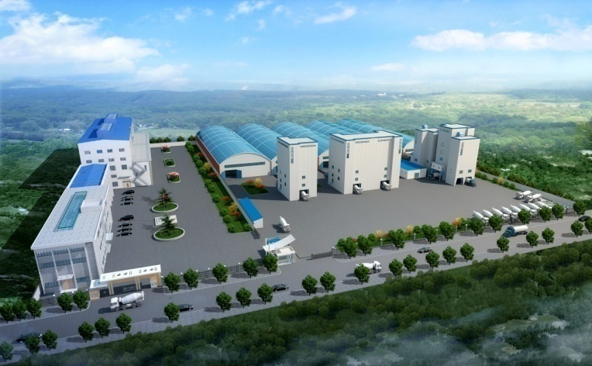
Environment friendly
dust
Efficient dust collectory
dust pipe sealed
waste water
Waste concrete sand and aggregate separating machine
waste water treatment pool
noise
Low noise motor
Whole plant enclosed
Directly reused
Mixer station enclosed
Operating space isolated from production space
waste water collecting pipe

Slide 25
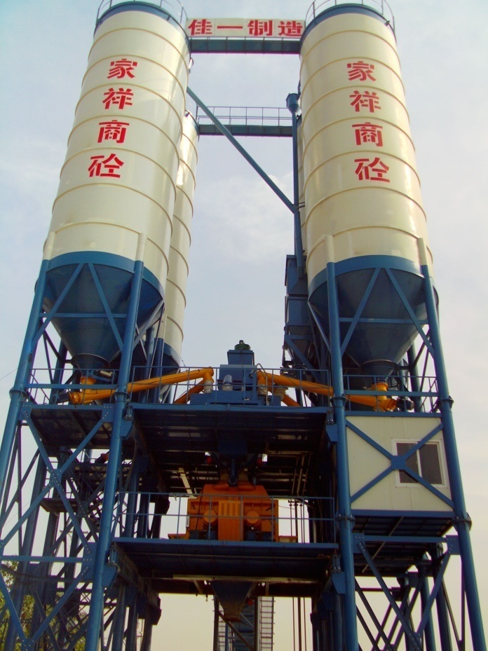
Environment protection: dust treatment
Reduce dust source
Employ high efficiency pulse dust collector, reduce dust emission to minimum level, more air volume, better dust collecting effect.
Cut off dust pollution way
Dust conveyed inside closed pipe line；
Dust collected directly enter into mixer to be mixed in concrete, achieve zero emission；
mixer station and powder silos are enclosed, stop dust escaping out.
Operating space isolated from production space, protect operator from harm of dust

Slide 26
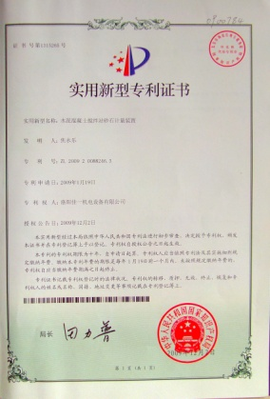
Zero emission central dust collector
type | description | characteristics
Silo top dust collector | dust collector installed on top of cement silo | Simple structure, easy installing, maintenance difficult, more units of dust collectors necessary.
Centralized dust collector room | dust to be centrally collected into a room located under the mixer station | Silo never “burst”, safety, maintenance convenient, collector quantity is least, regularly clean dust collector room necessary, cost low.
Zero emission central dust collector | collect dust into cement silo or cement charging truck to be reused. | Has advantages of usual centralized dust collector, collected dust can be reused, zero dust emission, no wastage, structure complicated, cost high.
Our dust treatment technology and dust collector devices have
been awarded with national patents

Slide 27
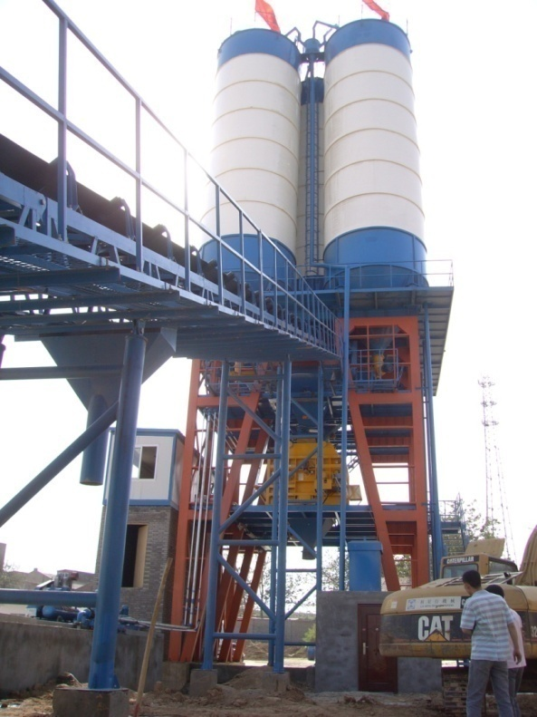
Zero emission dust centralized collecting device
“ Dust Centralized Collecting System” is connect all silos top together by pipe, centrally collect all dust together. Non-return valve installed in each dust collecting pipe to prevent cement leaking into others when silo filling.
Dust Collector Room：
The collected dust go to collector room located under the mixer station. The dusty air flow into the filter chamber, and filtered clean air discharged out into atmosphere.

Slide 28
Zero emission dust centralized collecting device
Zero emission dust centralized collecting device:
The collected dust directly feed into the dust collector located above the mixer station. Through the filter, dust is collected and clean air is discharged. The collected dust is directly feed through special pipe into the cement weighing hopper for recycling use. Therefore zero emission is achieved.

Slide 29
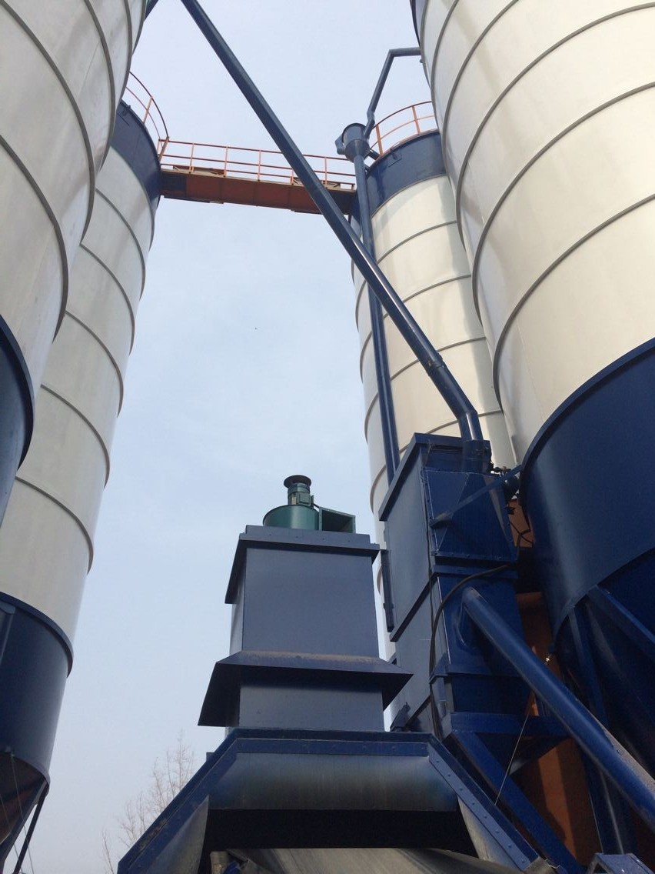
Dust Collector of Mixer Station
Pulse Air Back Blow Active Dust Collecting.
Fan draw in the dust from mixer and adhere onto filter bag. Pulse air flow vibrate the filter to make the dust feed back to mixer.
Special breath device can balance the pressure during charging and discharging, therefore avoid pushing and drawing the scale, this make weight measuring more accurate.

Slide 30
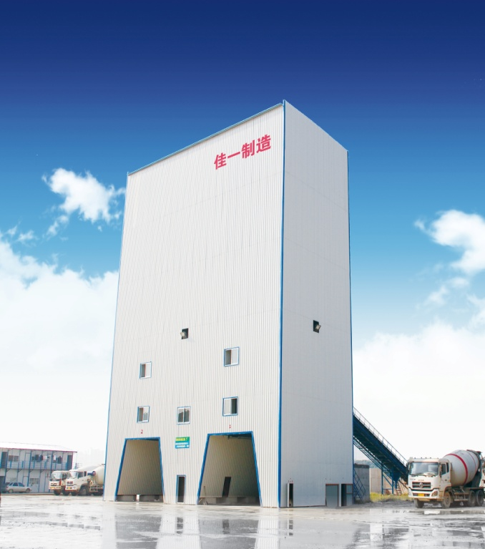
Environment Protection
Reduce pollution source
Compact plant, motor smaller, noise less
Cut off noise transmittal way
Whole plant enclosed，isolate the noise from the whole plant.
Aggregate storage area enclosed, isolate the noise from loader / truck.
Operator space isolated from production space, protect operator from harm of dust.
select low noise level motor, decrease noise decibel

Slide 31
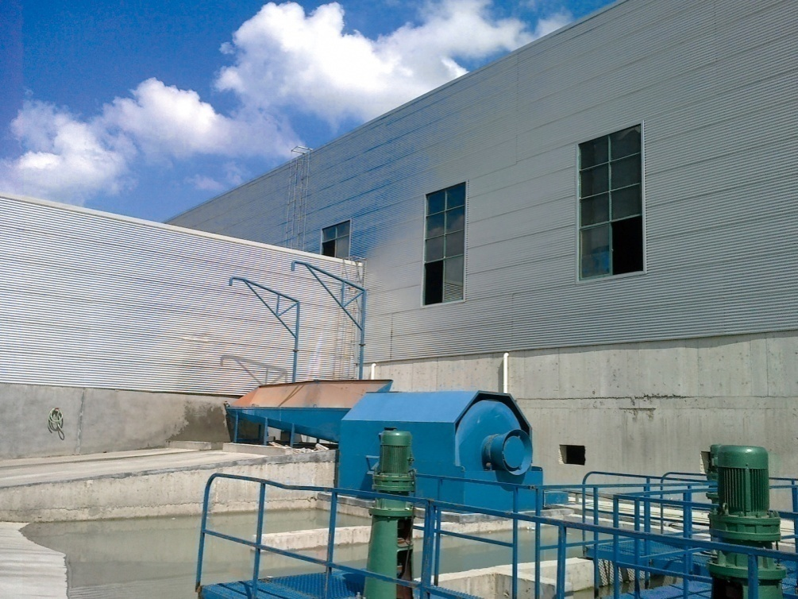
Environment protection: waste water treatment
Reduce waste water source
Equip with aggregates separating machine to treat waste water from mixer washing
Cut off polluting way
Equip with truck body washing device.
Yard waste water collecting channels cut off spreading flow the dirty water
Equip with waste water treating pool, centrally collecting device, forbid careless discharging.

Slide 32
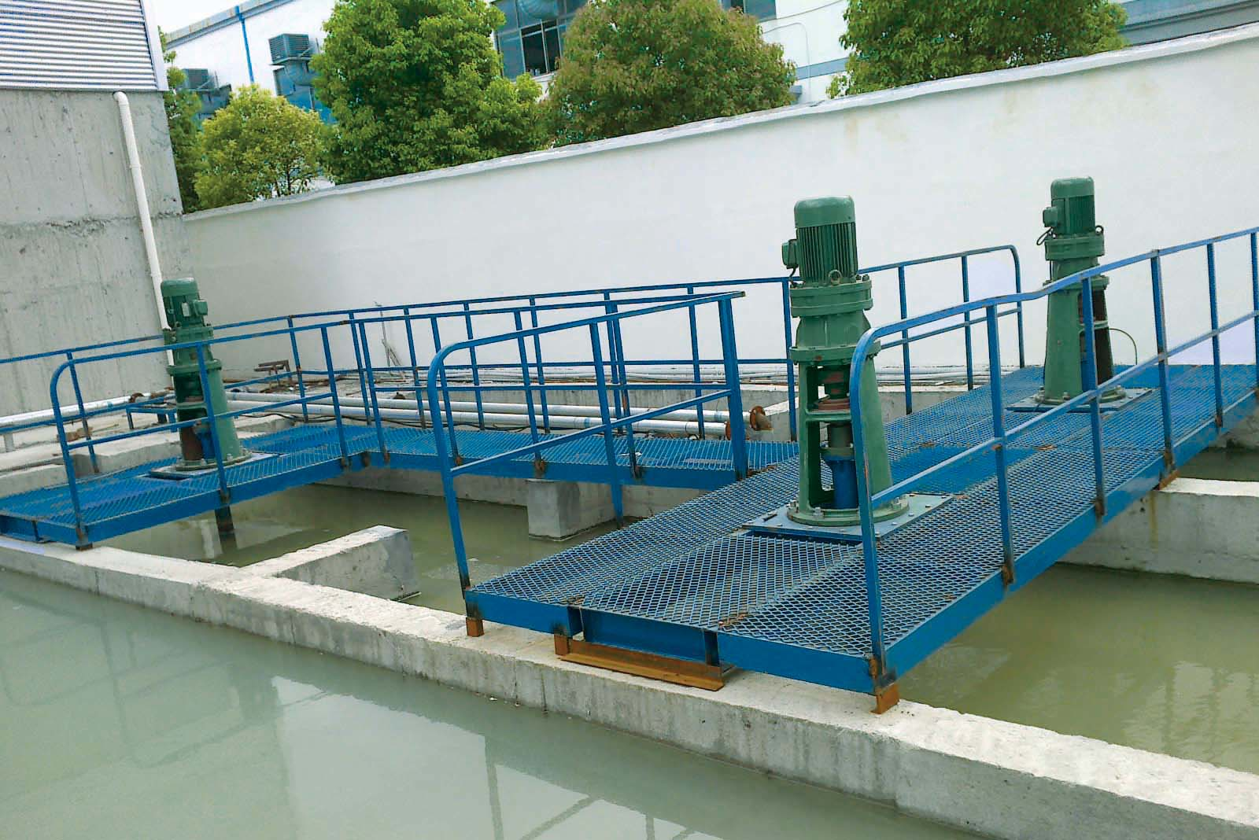
Equip with aggregates separating machine, one unit can be used for two mixer truck washing. Separated aggregates can be reused. Waste water treatment meet requirements.
Waste water recycling device
3-stage waste water sediment process: dirty water pool, sediment pool, clean water pool. The clean water will be reused

Slide 33
Wonderful Appearance
The plant looks splendid

Slide 34
Other characteristics of the Plant
1.Mixer
2.Subtraction weighing used for powder materials
3.Self-aligning belt
conveyor
4.Automatic
butterfly valve

Slide 35
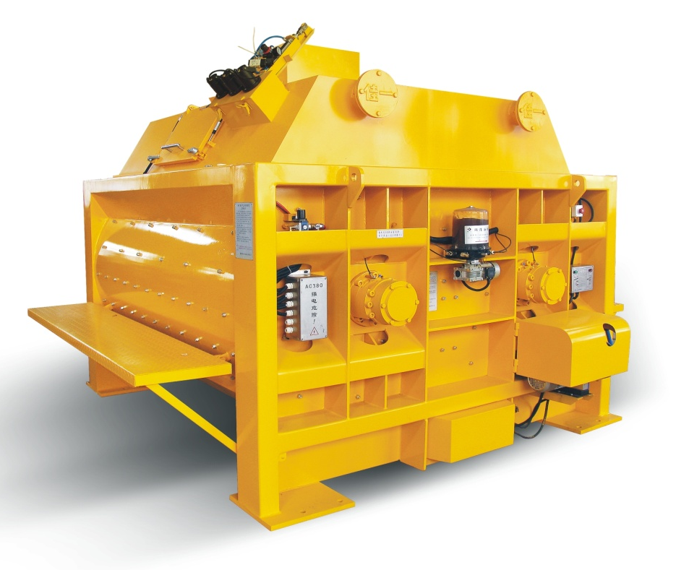
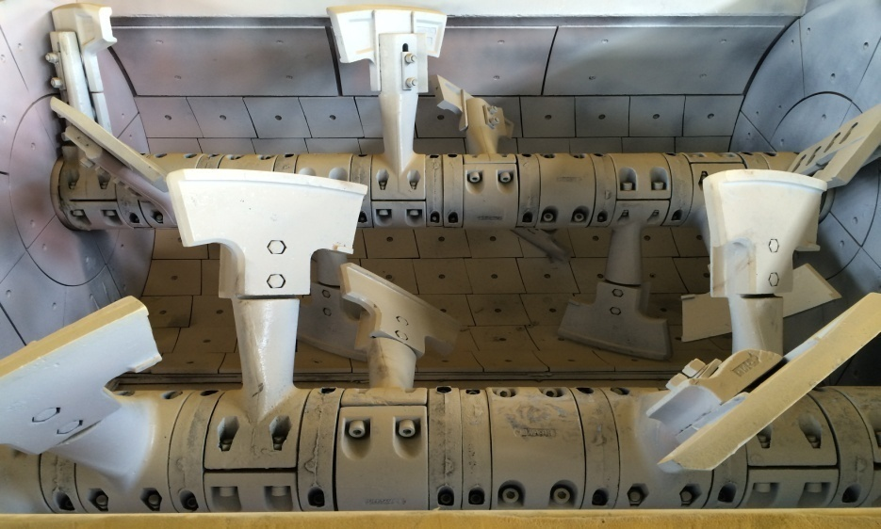
Horizontal Twin Shaft Forcible Concrete Mixer
Strong, abrasion resistant
Made with Italian technology. The “ω” mixing bowl is made from thick steel plate, strength is high. It is lined with wear resistant alloy liner, service life long, easy replacing.

Slide 36
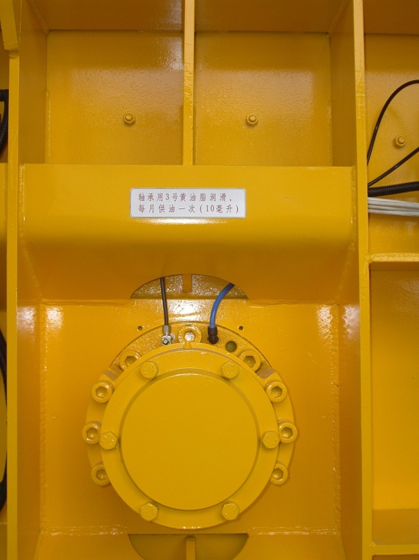
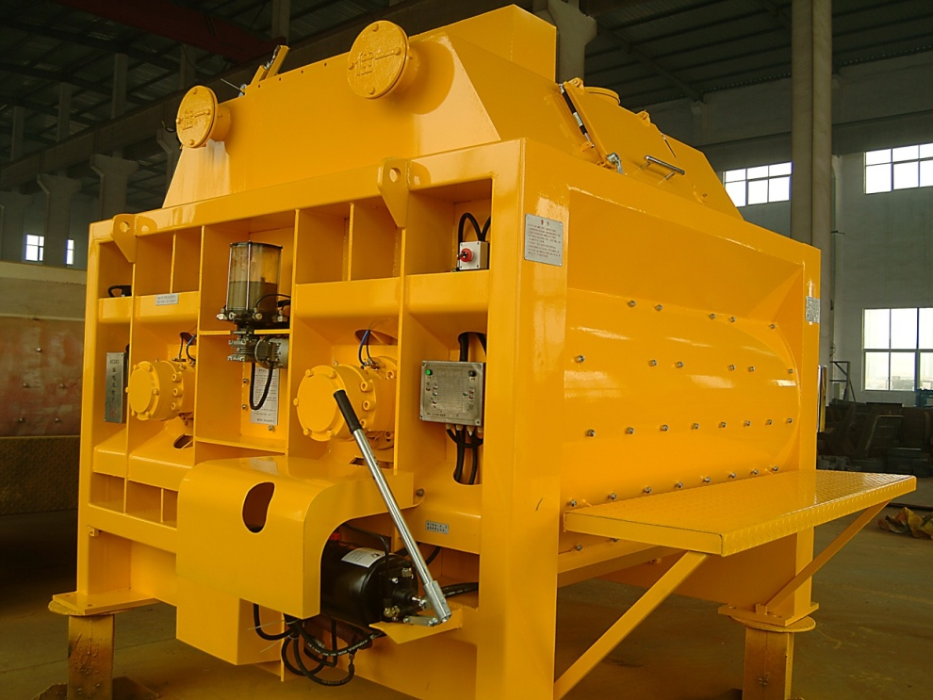
Horizontal Twin Shaft Forcible Concrete Mixer
No leakage at shaft ends
Shaft end construction：upgrade material and improve machining process, make it stronger, better performance to prevent slurry from leakage.
Shaft end seal：adopt dual seals, combination of air tight seal and oil seal, better sealing, more reliable.

Slide 37
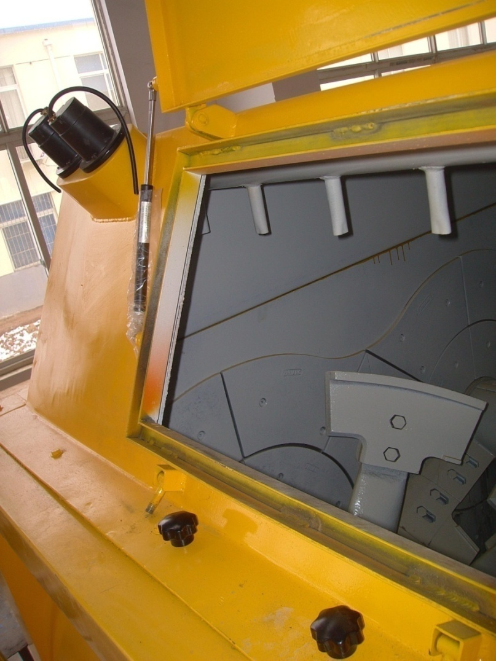
Horizontal Twin Shaft Forcible Concrete Mixer
No concrete adhere onto and embrace around mixing shaft
There is pressurized water shower inside the mixer, combined with materials charging at correct sequence and optimized falling point, make materials no adhere and embrace the mixing shaft. Only necessary cleaning work is removing floating dust on the upper hood. Therefore reduce manually cleaning times, save labor, decrease accident ratio.

Slide 38
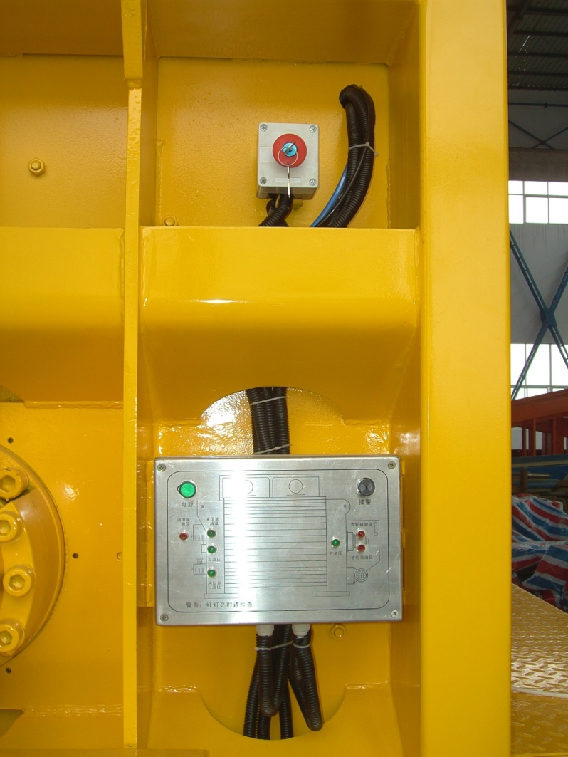
Horizontal Twin Shaft Forcible Concrete Mixer
Safety and monitoring
Safety:
In case emergency, the push button can be pushed down and the machine can be immediately stopped
Monitoring device：
It can monitor level and temperature of oil in the gear box and in hydraulic power pack used for concrete discharging.

Slide 39
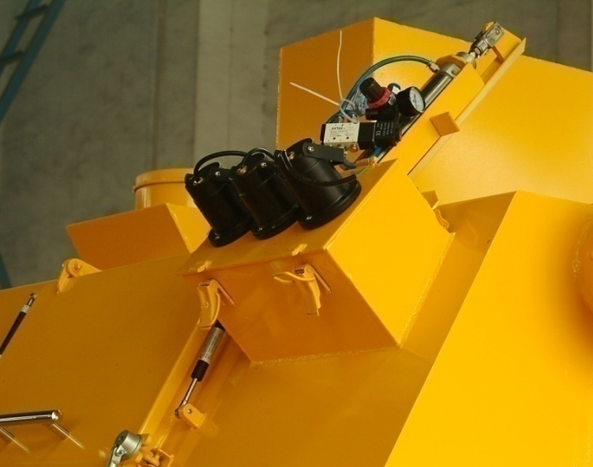
Horizontal Twin Shaft Forcible Concrete Mixer
Slump monitoring
Direct watching:
There is infrared camera system installed on the mixer, the video signal can be transmitted to monitor screen inside operator room, therefore the operator can observe the slump at any time
Indirect watching:
May check mixing motor current curve in control interface displayed on the monitor screen. The less the current the more the slump, vice versa.

Slide 40
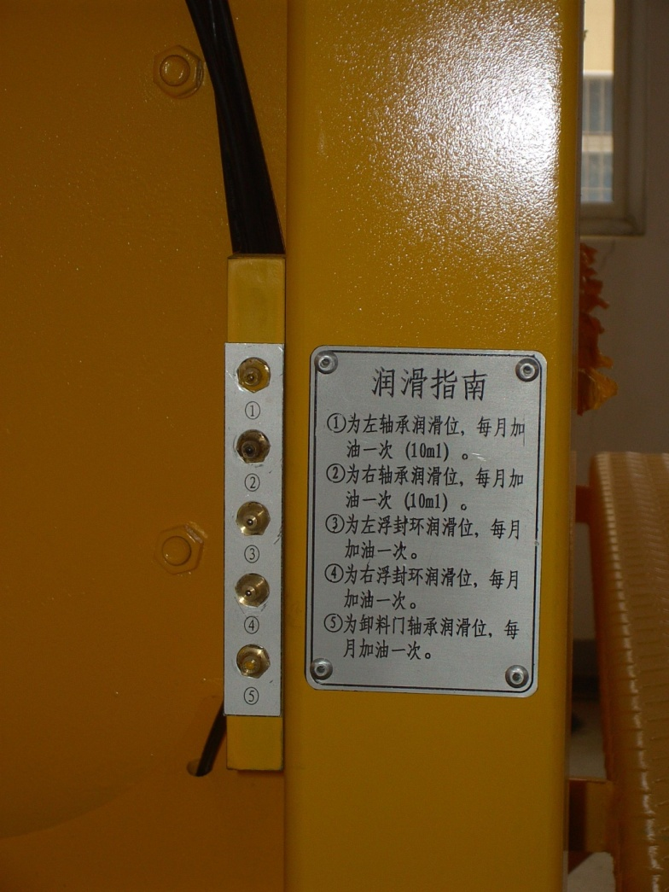
Horizontal Twin Shaft Forcible Concrete Mixer
Centralized lubrication
The mixer adopt centralized lubrication, greasing efficiency enhanced remarkably, careless greasing omission avoided.

Slide 41
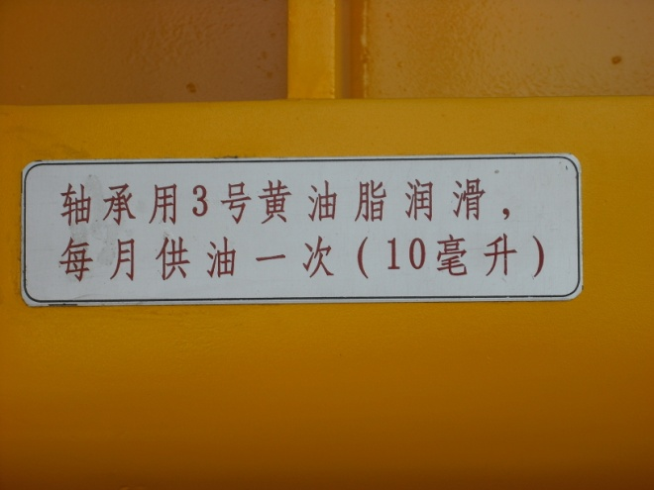
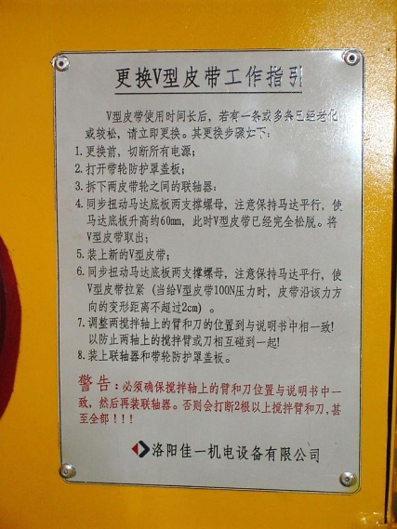
Horizontal Twin Shaft Forcible Concrete Mixer
Instruction plate
The instructions make operation simple and accurate
This instruction make maintenance easy
This warning make your operation more safe

Slide 42
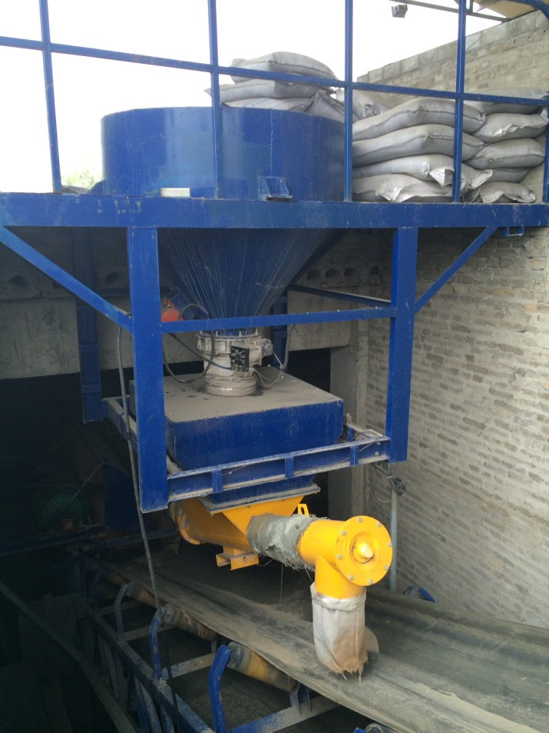
Subtraction weighing used for powder additive
Subtraction weighing technology used for powder additive dosing. Connect screw conveyor onto weighing hopper, by the screw conveyor the additive is discharged on the aggregates which are already on the running belt, therefore prevent the additive adhere onto belt.
This device can improve dosing accuracy, and directly controlled with control system, make operation convenient, and avoid careless charging omission and /or extra charging.

Slide 43
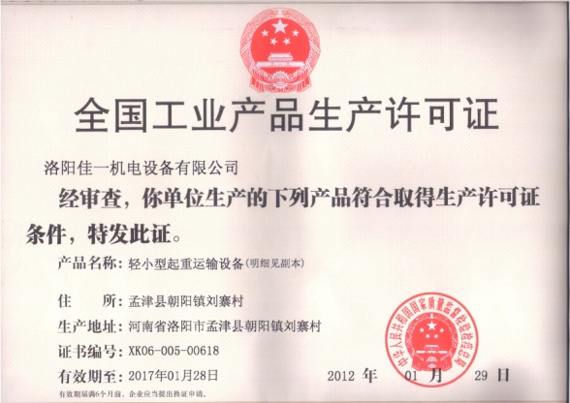
Belt conveyor employ trough-forerake-support rollers, it can be self-adjusted to keep proper alignment while the belt running, to avoid materials falling out. It is maintenance free.
Self-aligning belt conveyor
we own national license to manufacture belt conveyor. License No. XK06-005-00618

Slide 44
The automatic butterfly valve open when screw conveyor start, and shut off when screw conveyor stop. Therefore the motor start with light load. It can avoid impact and leaking due to cement collapse in silo, and avoid cement over charging and wastage.
Automatic butterfly valve for powder silo
Automatic butterfly valve
Manually butterfly vale

Slide 45
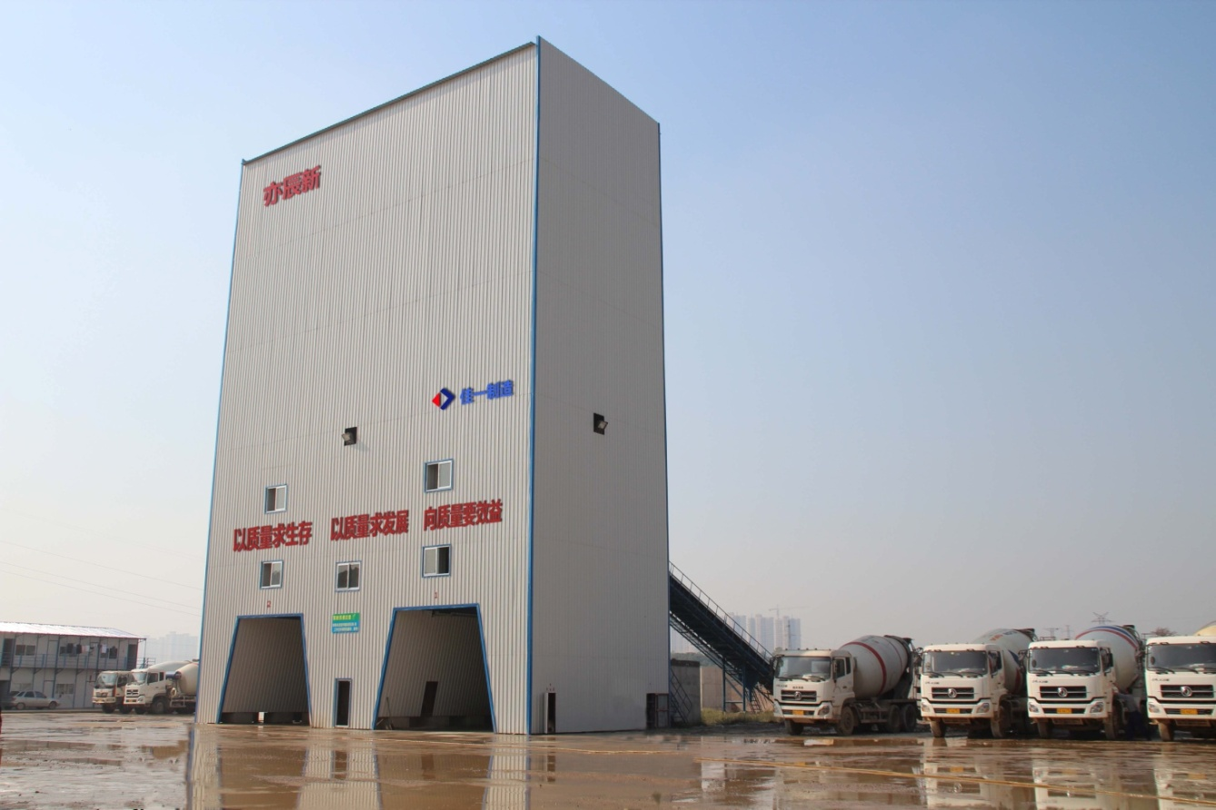
Plant example
China·Wuhan
Yechen New Concrete Plant
Environment Protection Type
2*HZS180B Twin Plant

Slide 46
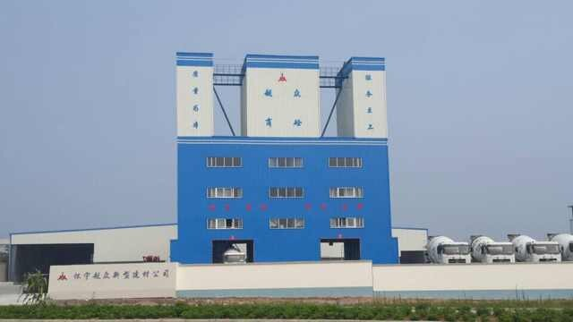
Plant examples
China·Anqing
Yuezhong Concrete Plant
2*HZS270C Twin Plant

Slide 47
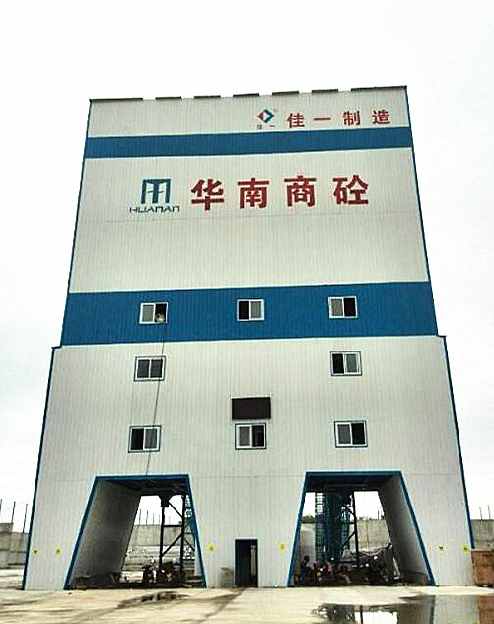
Plant examples
China·Wuhan
Huanan Concrete Plant
2*HZS180B Twin Plant

Slide 48
Plant examples
China·Luoyang
Tianxing Concrete Plant
2*HZS180C Twin Plant

Slide 49
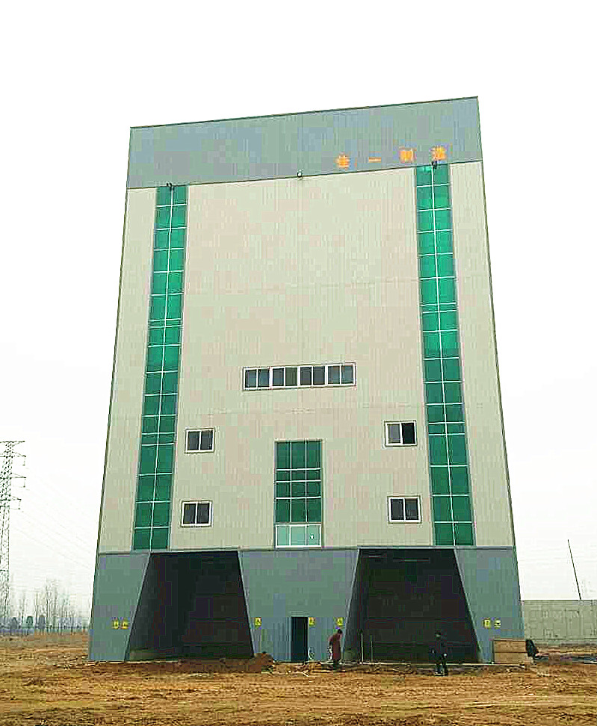
Plant examples
China·Zhengzhou
Xuankang Concrete Plant
Environment Protection Type
2*HZS180B Twin Plant

Slide 50
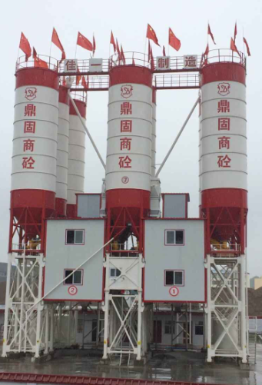
Plant examples
China·Luoyang
Dinggu Concrete Plant
Environment Protection Type
2*HZS180C Twin Plant

Slide 51
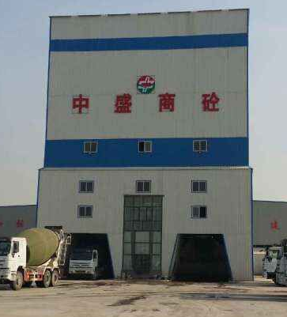
Plant examples
China·Shijiazhuang
Zhongsheng Concrete Plant
Environment Protection Type
2*HZS180B Twin Plant

Slide 52
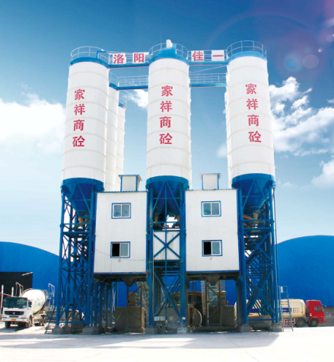
Plant examples
China·Wuhan
Jiaxiang Concrete Plant
2*HZS180C Twin Plant

Slide 53
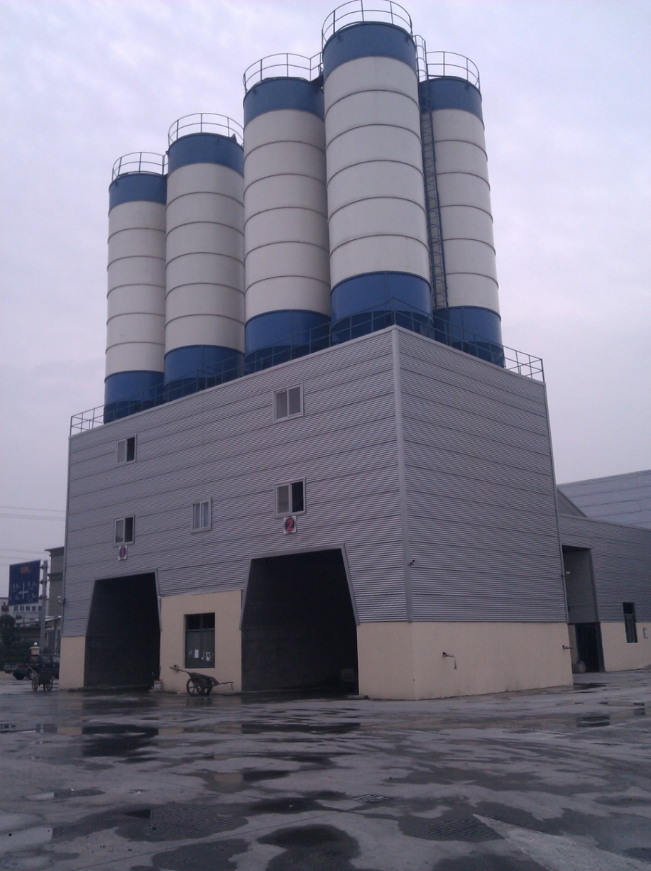
Plant examples
China·Wuhan
Zhuyuan Concrete Plant
2*HZS180B Twin Plant

Slide 54
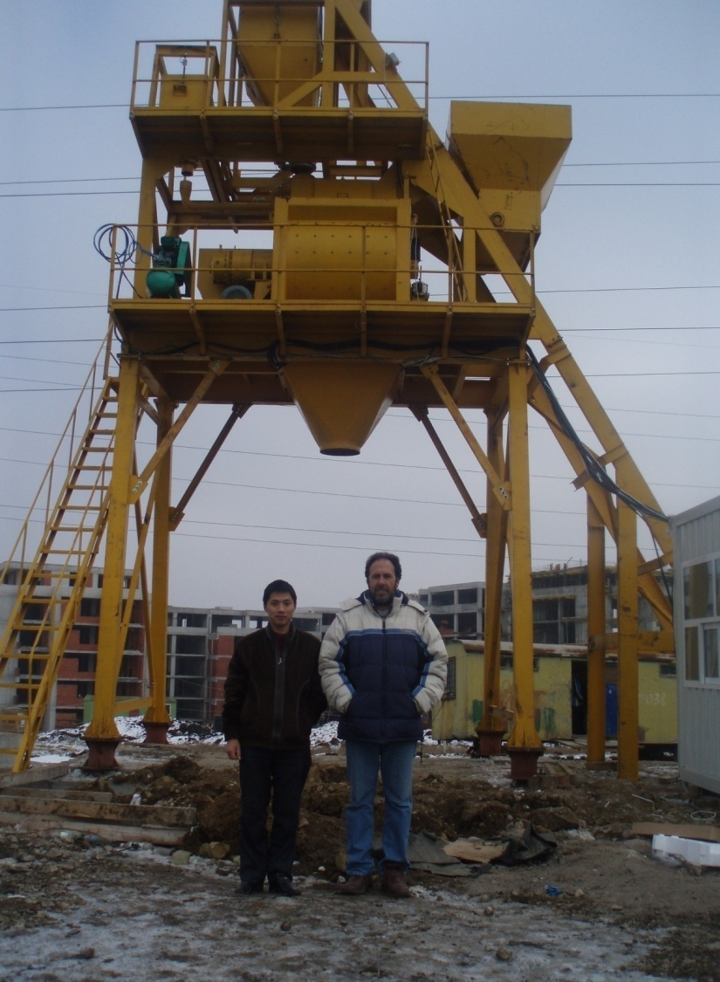
Plant examples
Bulgaria
Economical Concrete Batching Plant HZS75A

Slide 55
Plant examples
China·Luoyang
Zhongkun Concrete Plant
2*HZS180C Twin Plant

Slide 56
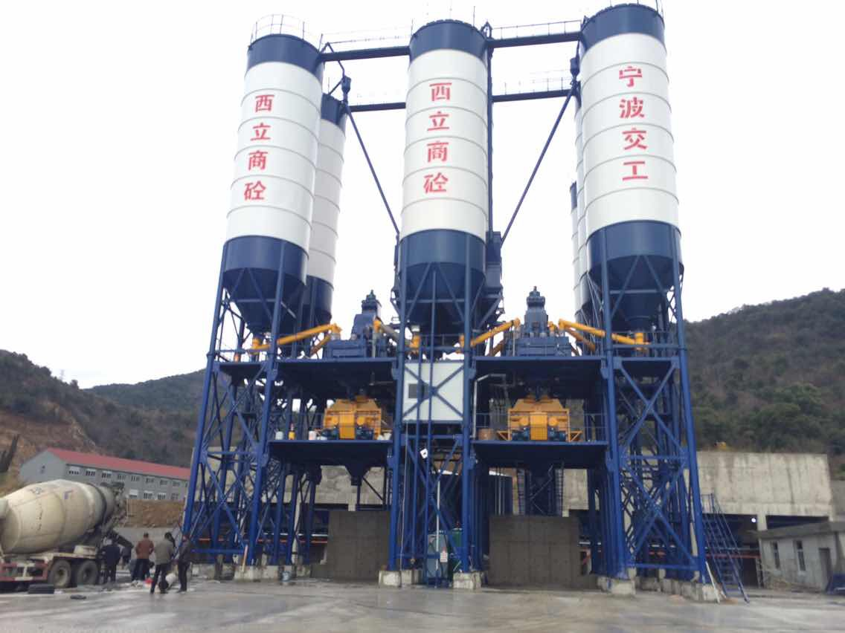
Plant examples
China·Ningbo
Xili Concrete Plant
2*HZS180C Twin Plant

Slide 57
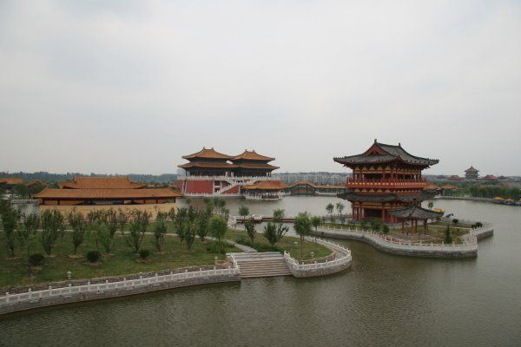
You are welcome to visit our beautiful city
Ancient Times
As Capital City of China for 13 Dynasties
With Thousands Years History
Origin of Chinese Culture and Civilization
Nowadays
A Famous Modern Innovative Industrial City,
Chinese Machinery Manufacturing Base

Slide 58
You are welcome to visit our beautiful city
Longmen Grottoes
World Culture Heritage

Slide 59
You are welcome to visit our beautiful city
洛阳地脉花最宜
牡丹尤为天下奇
Luoyang Peony Flower Is The Best in The World

Slide 60
You are welcome to visit our beautiful city
如花绽放 ·水席一绝
【牡丹燕菜】
Delicious Royal Food

Slide 61
Thanks
Wish a successful business cooperation !
Mr.Li Jinfu, Oversea Sales Manager
Mobile/wechat/whatsApp: +86 18937917628
Skype: lijinfu58 QQ: 2956729
E-mail: salesmanager.ljf@sinbrma.com

